Slide 1
Heart Disease Diagnostic Analysis

Slide 2
PROBLEM STATEMENT
Health is a critical aspect of life, and the COVID-19 pandemic highlighted the importance of being prepared for health-related challenges. In this project, we are tasked with analyzing heart disease diagnostic data to better understand key factors that contribute to heart disease. The goal is to extract meaningful insights from the dataset, visualize relationships between different attributes, and create a comprehensive dashboard that aids in future health preparedness.

Slide 3
Dataset overview
The directory contains two files:
Dataset Details.txt: This file likely contains information about the dataset, such as the attributes, data description, or any other relevant details.
Heart Disease data.csv: This is the primary dataset in CSV format, which we'll use for our analysis.

Slide 4
Attributes Information
Age: The age of the patient.
Sex: The gender of the patient (0 = Female, 1 = Male).
Chest Pain Type: Type of chest pain experienced by the patient.
Resting Blood Pressure: Blood pressure of the patient at rest.
Serum Cholesterol: Cholesterol level in mg/dl.
Fasting Blood Sugar: Indicates if fasting blood sugar > 120 mg/dl.
Resting ECG Results: Resting electrocardiographic results (values 0, 1, 2).
Maximum Heart Rate Achieved: The highest heart rate the patient achieved.
Exercise Induced Angina: Whether exercise caused angina (yes/no).
Oldpeak: ST depression induced by exercise relative to rest.
Slope of Peak Exercise ST Segment: The slope of the peak exercise ST segment.
Number of Major Vessels: Number of major vessels colored by fluoroscopy.
Thal: Thallium stress test result (0 = normal, 1 = fixed defect, 2 = reversible defect).
Target: Diagnosis of heart disease (0 = No Disease, 1 = Disease)

Slide 5
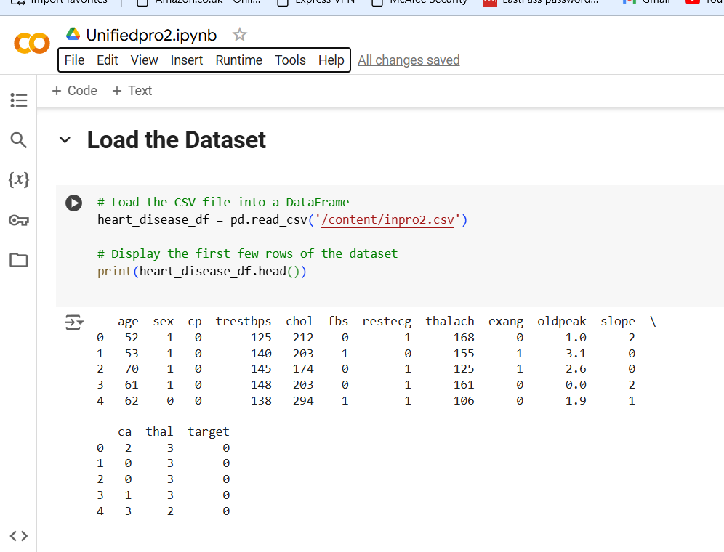
ETL (Extract, Transform, Load) Process
Extract: The dataset was extracted from the provided CSV file.
Transform:
Categorical variables like gender were mapped to more readable formats (e.g., 0 = Female, 1 = Male).
Numerical attributes were normalized using StandardScaler to prepare the data for analysis.
Missing values were checked and handled appropriately.
Load: The cleaned and transformed data was loaded into a DataFrame for analysis.

Slide 6
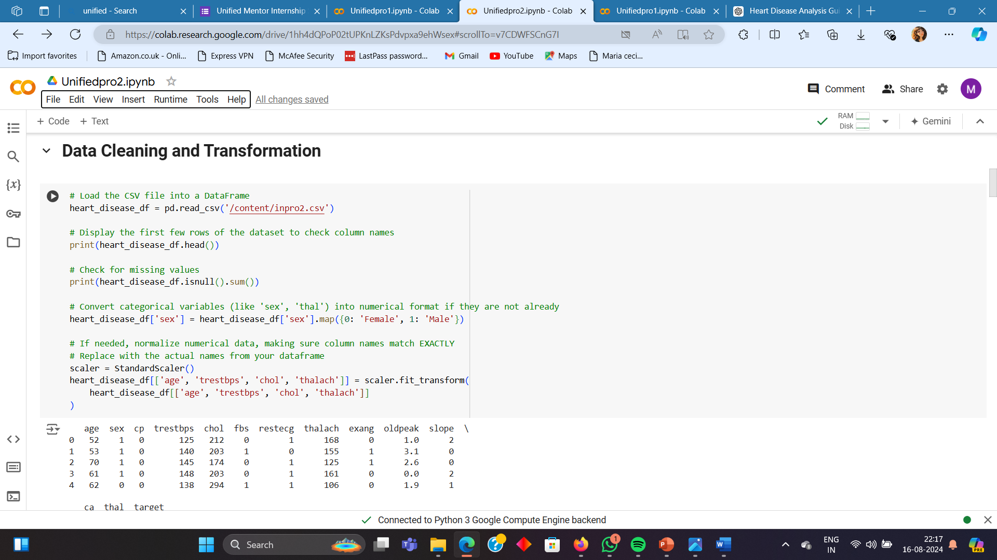
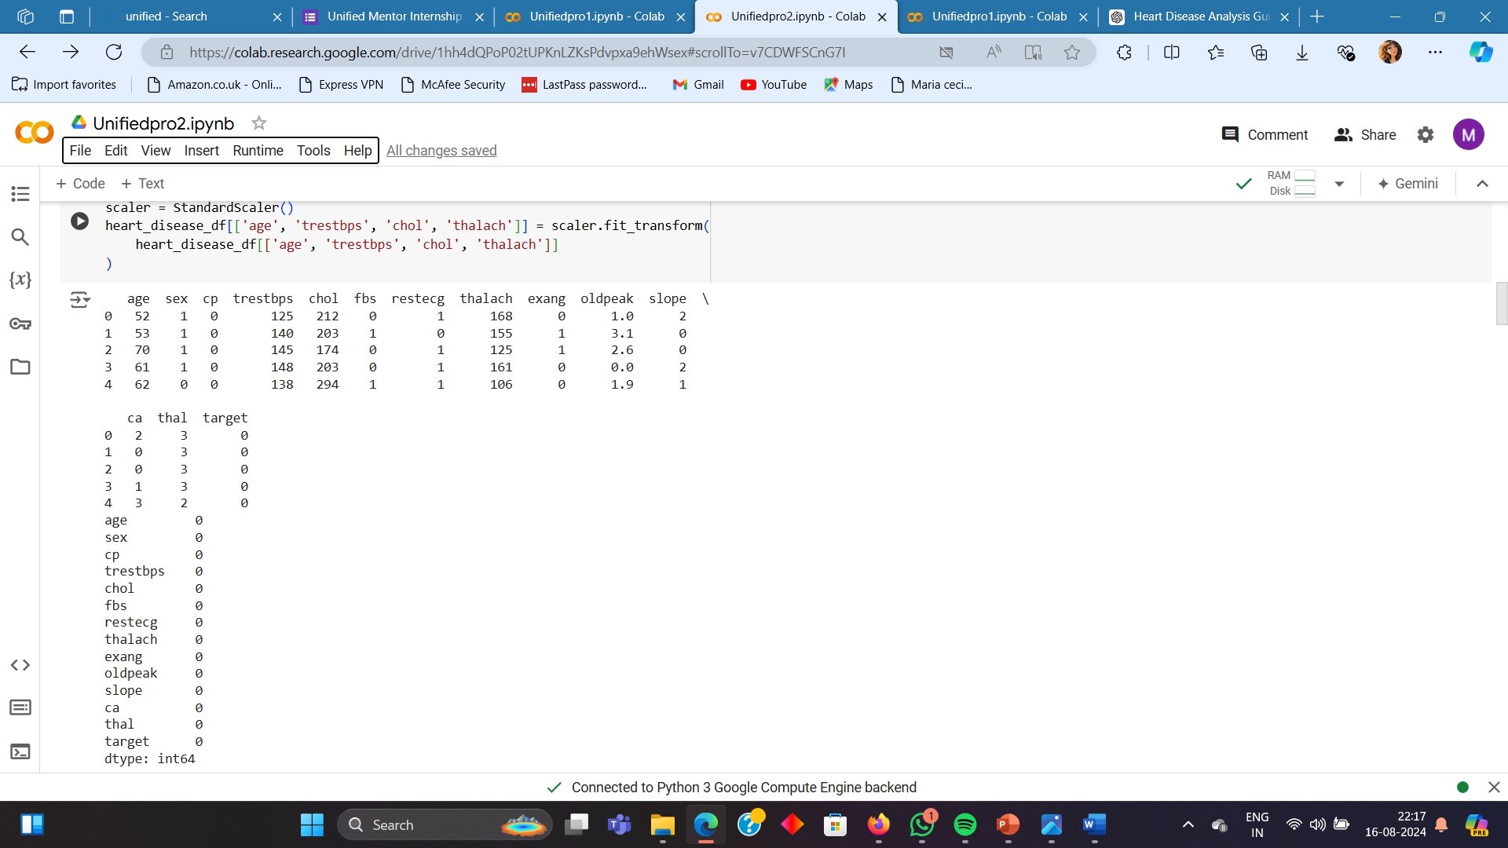
Cleaning and Transformation

Slide 7
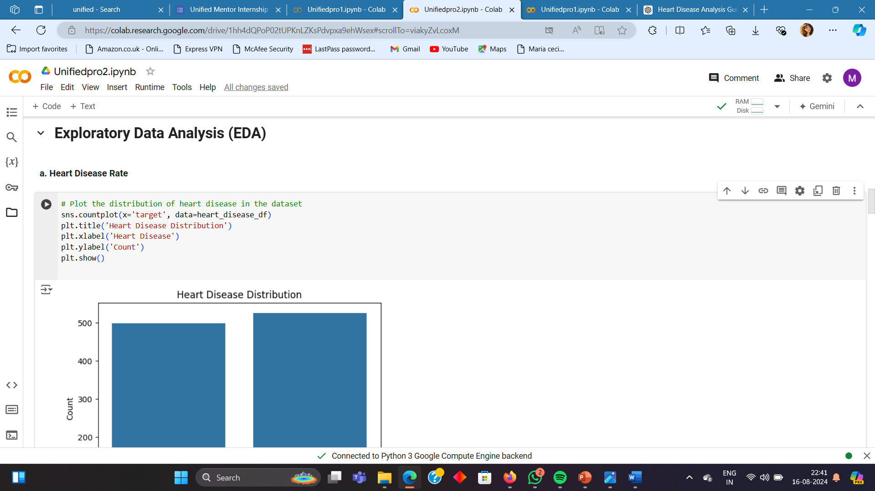
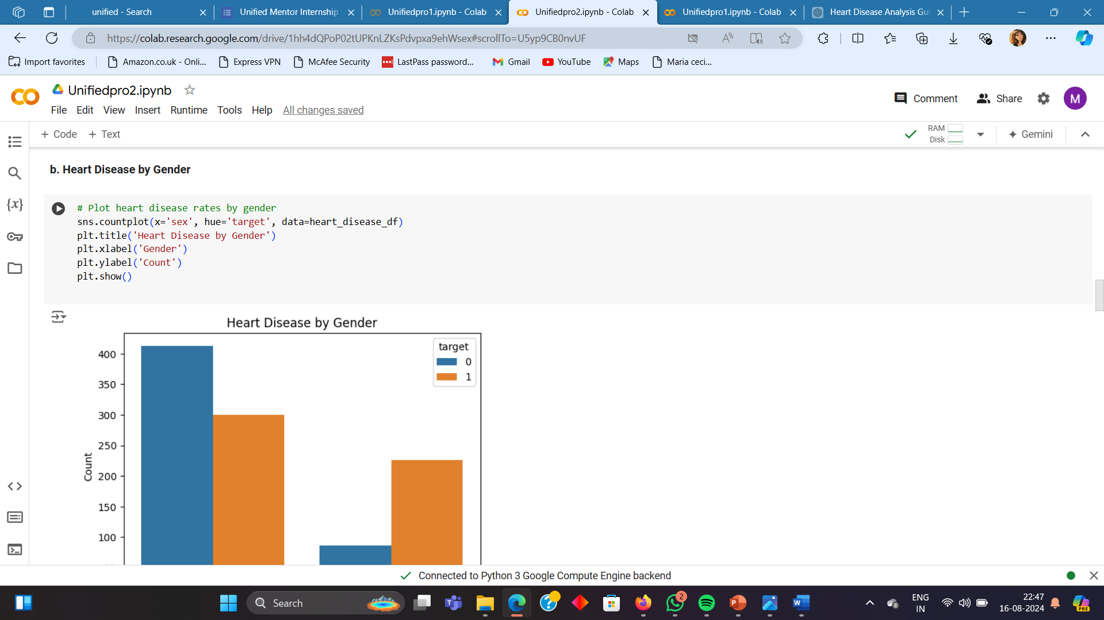
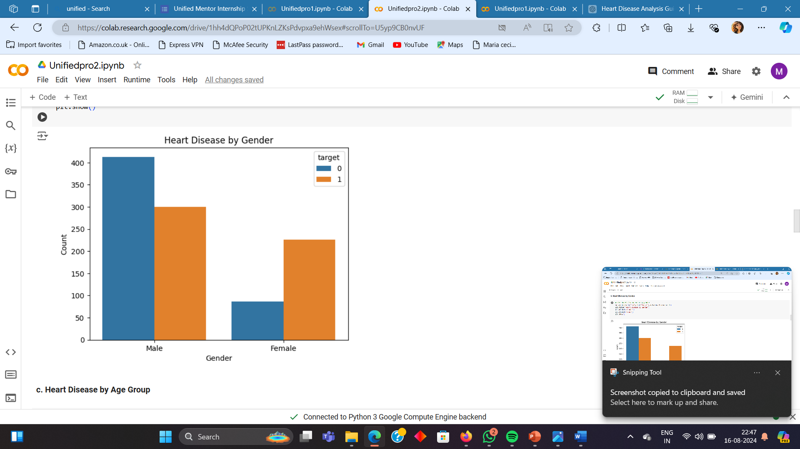
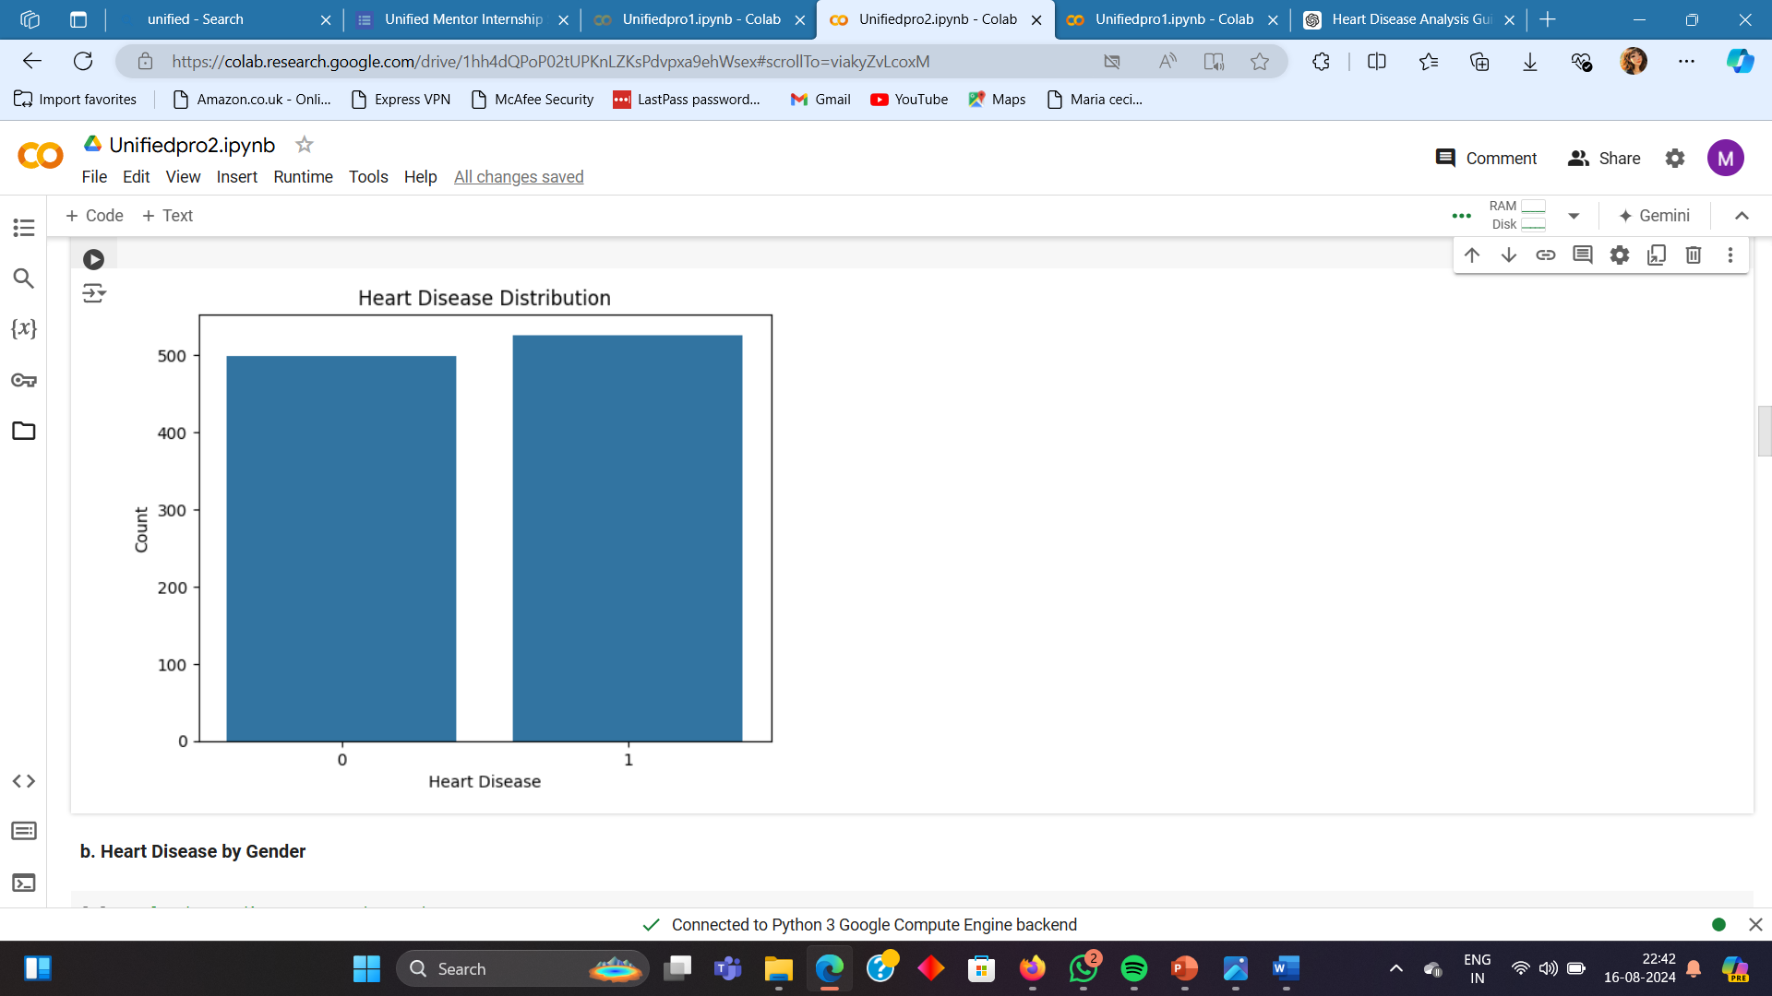
Exploratory Data Analysis(EDA)

Slide 8
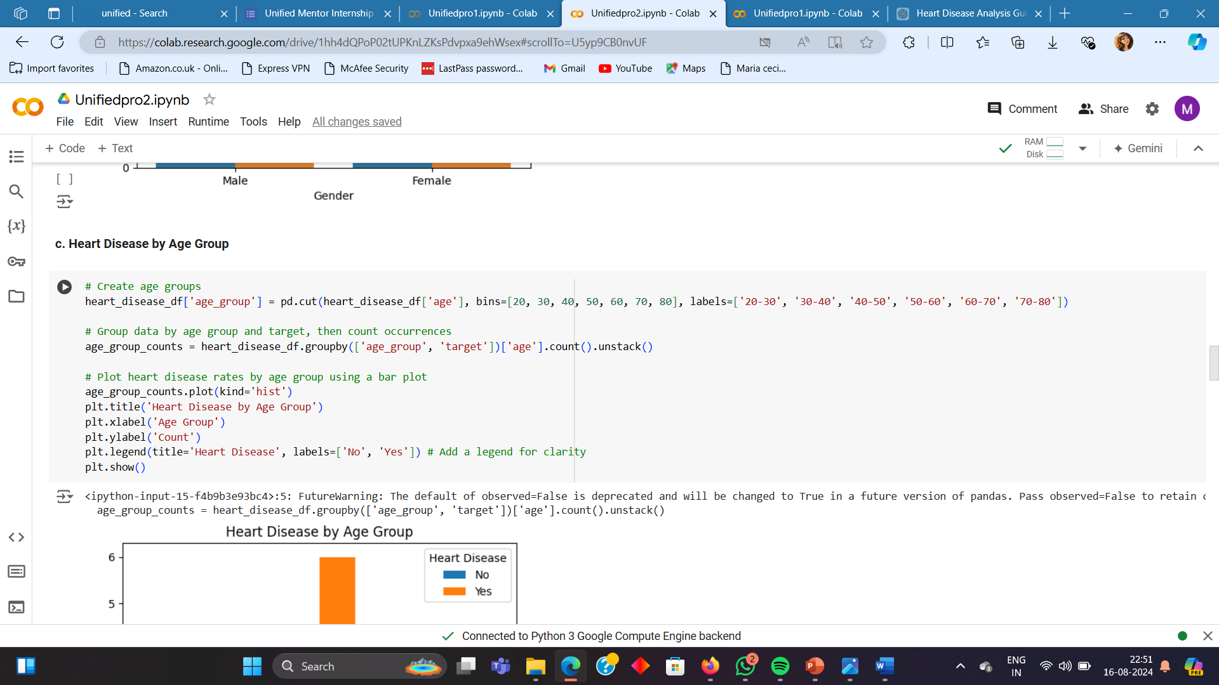
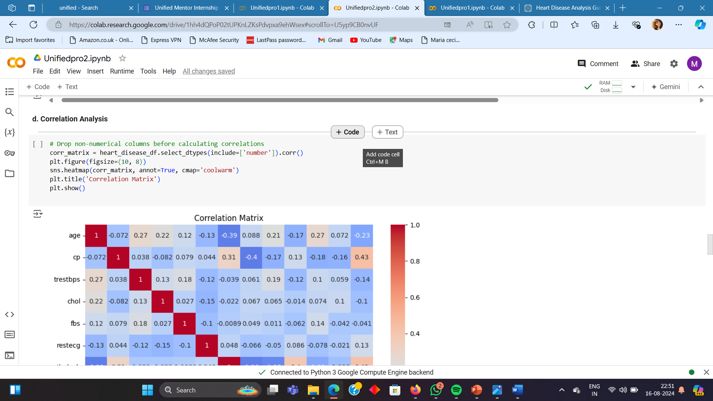
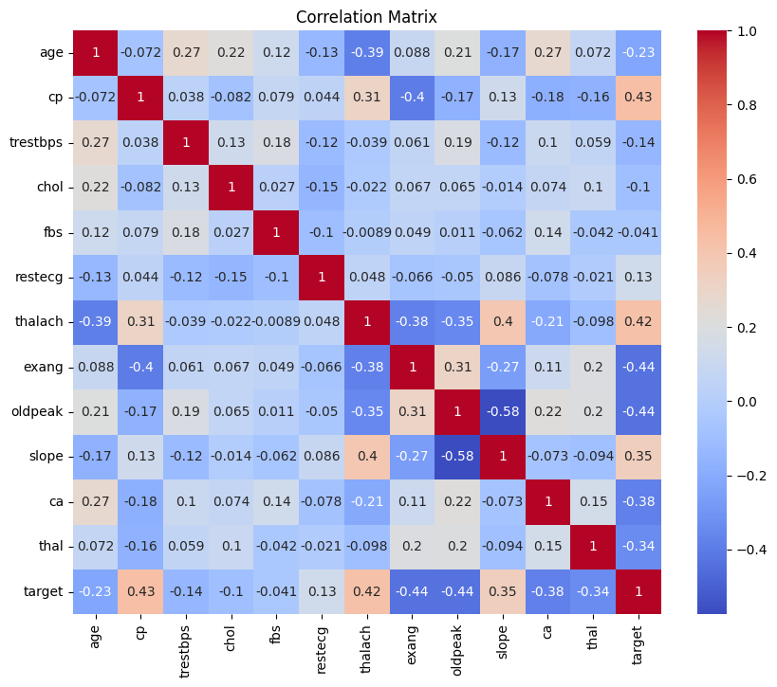
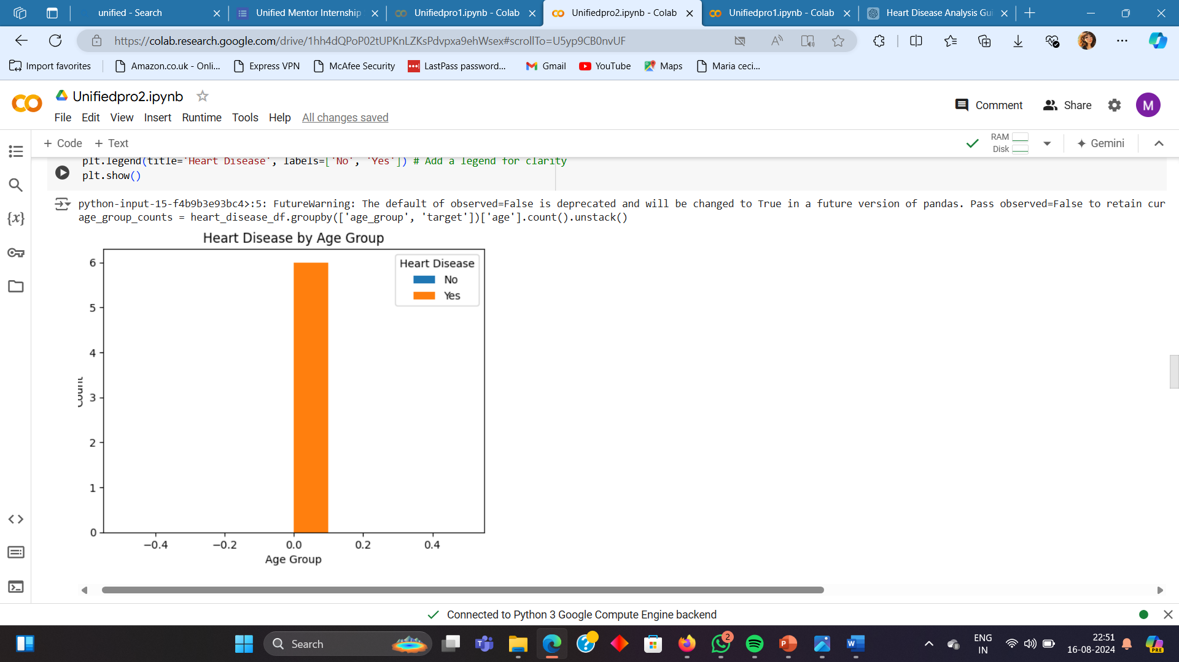
Exploratory Data Analysis(EDA)

Slide 9
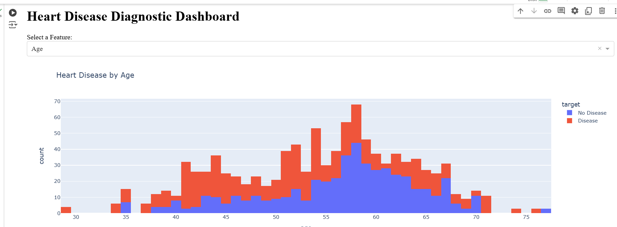
Dashboards

Slide 10
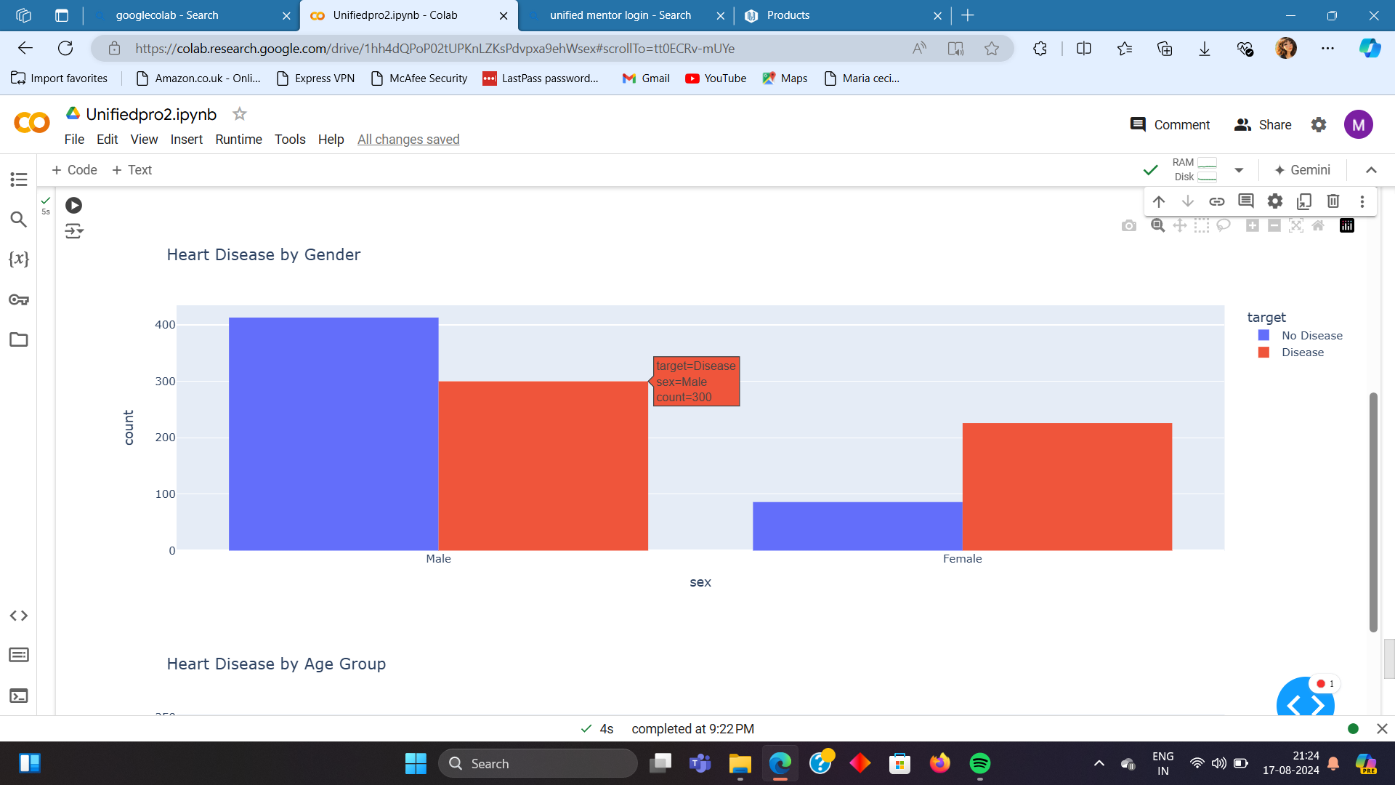
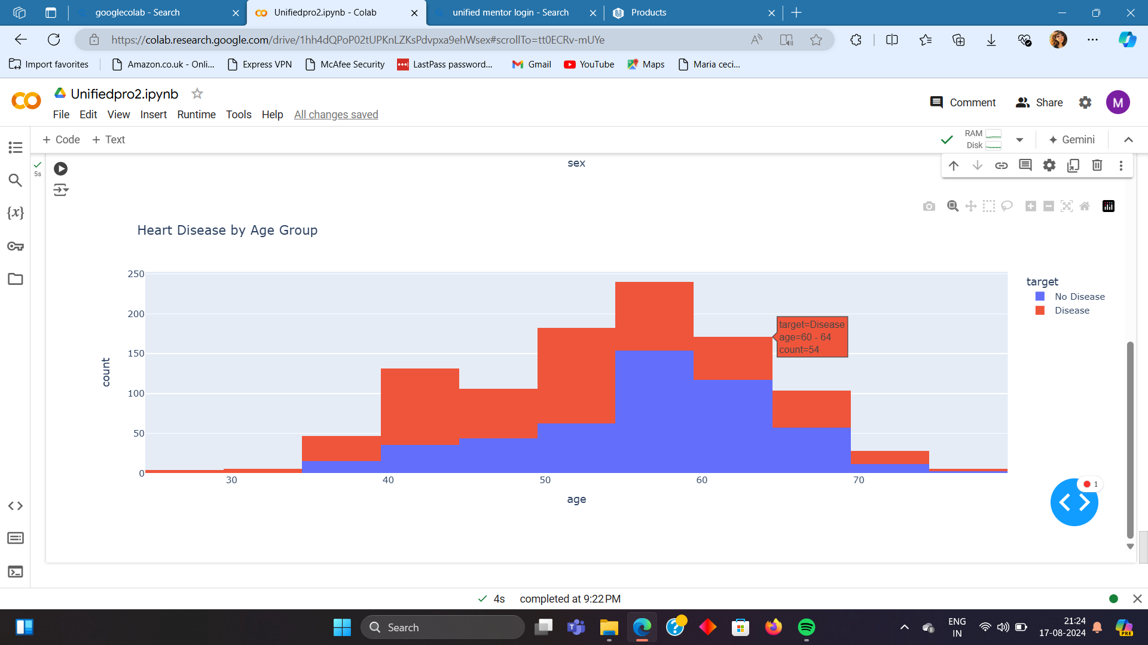
Dashboards

Slide 11
Results and Insights
Gender Impact: Males were found to have a higher prevalence of heart disease compared to females in the dataset.
Age Factor: The likelihood of heart disease increases with age, particularly in individuals aged 50 and above.
Key Correlations: Attributes like age, resting blood pressure, and cholesterol levels showed significant correlations with heart disease, indicating they are crucial factors to monitor in patient

Slide 12
Conclusion
The analysis provided key insights into heart disease diagnosis, highlighting important factors like gender, age, and cholesterol levels that influence the risk of heart disease. The dashboard created in this project serves as a useful tool for visualizing these relationships and can aid healthcare professionals in making data-driven decisions

